Slide 1
GIS To AERMOD Tool 2

Slide 2
Tool Description
Draw Lines that converts to AERMOD Geometry

Slide 3
UI Design (1) – Draw Module
GTA (GIS-TO-AERMOD)
Draw
Road
Receptors
Emissions
Compilation
Results
Upload graph
Define scale
Locate reference
Draw Polyline

Slide 4
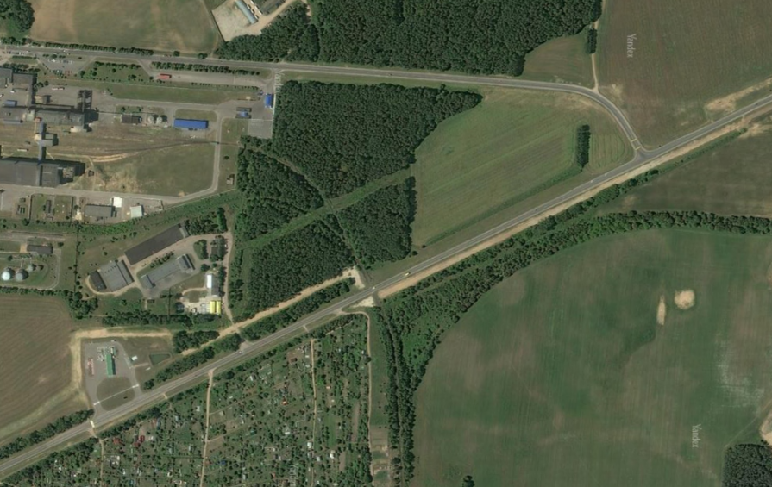
UI Design (1) – Draw Module
GTA (GIS-TO-AERMOD)
Click this button to upload an image with roads
Draw
Road
Receptors
Emissions
Compilation
Results
Upload graph
Define scale
Locate reference
Draw Polyline

Slide 5
UI Design (1) – Draw Module
GTA (GIS-TO-AERMOD)
Click this button, then user can draw any line with two nodes and enter the distance between two nodes
Draw
Road
Receptors
Emissions
Compilation
Results
Upload graph
Define scale
Locate reference
Draw Polyline

Slide 6
UI Design (1) – Draw Module
GTA (GIS-TO-AERMOD)
Click this button, then user can draw any line with two nodes and enter the distance between two nodes
Draw
Road
Receptors
Emissions
Compilation
Results
Upload graph
Define scale
Locate reference
Draw Polyline
Scaling
Enter distance between nodes:
50.3
m

Slide 7
UI Design (1) – Draw Module
GTA (GIS-TO-AERMOD)
Click this button, then user can click one point and set as reference point (0,0)
Draw
Road
Receptors
Emissions
Compilation
Results
Upload graph
Define scale
Locate reference
Draw Polyline

Slide 8
UI Design (1) – Draw Module
GTA (GIS-TO-AERMOD)
Click this button, then user can draw multiple polylines.
Each polyline can have at most 10 nodes
The drawing of each polyline is ended either nodes reaches 10, or user right click the mouse button, then a window pop up for additional information of the polyline
Draw
Road
Receptors
Emissions
Compilation
Results
Upload graph
Define scale
Locate reference
Draw Polyline

Slide 9
UI Design (1) – Draw Module
GTA (GIS-TO-AERMOD)
Click this button, then user can draw multiple polylines.
Each polyline can have at most 10 nodes
The drawing of each polyline is ended either nodes reaches 10, or user right click the mouse button, then a window pop up for additional information of the polyline
Draw
Road
Receptors
Emissions
Compilation
Results
Upload graph
Define scale
Locate reference
Link information
LinkID
1
(default as 1,2,3,..)
Draw Polyline
Link Width (m)
16
Road Type
2
OK

Slide 10
UI Design (1) – Draw Module
From this Draw Module, a geodaframe should be created, very similar to ‘rd_list’ in tool 1, with the following columns:
linkID (unique ID of each polyline, String, default as 1,2,3,…). For each user click ‘OK’ to finish link information, the tool needs to check for duplicated linkID, if so, give an error window message (‘The linkID [linkID] was duplicated’)
rdTypeID (road type ID. This can also be customized by users)
wd (road width as input from user, has to be > 0, float)
bw (wd divided by 2)
n (number of nodes, generated based on the linestring)
geometry (LineString, generated based on the drawings)

Slide 11
UI Design (1) – Draw Module
GTA (GIS-TO-AERMOD)
The rd_list column information can be viewed in the table (linkID, rdTypeID, wd and bw can be changed. Others cannot.)
When select one row, the corresponding polyline in the map will be highlighted. Users can delete the polyline using the Delete button.
User can use Confirm button to store values from table to rd_list geodataframe
Draw
Road
Receptors
Emissions
Compilation
Results
Upload graph
Define scale
Locate reference
Draw Polyline
linkID | rdTypeID | wd | bw | n | geometry
1 | 1 | 12 | 6 | 5 | Linestring((xxx,xxx,xx))
2 | 1 | 12 | 6 | 10 | Linestring((xxx,xxx,xx))
3 | 2 | 10 | 5 | 3 | Linestring((xxx,xxx,xx))
Delete
Confirm

Slide 12
UI Design (4) – Draw Module
GTA (GIS-TO-AERMOD)
Data
Road
Receptors
Emissions
Compilation
Results
Skip the “Emission Module”
Input for Emission Conversion
1. Type or upload link emissions
linkID | Emission rate
1 | 120.3
2 | 11.44
3 | 111
Or upload csv
Upload emission csv
Em Unit
g/mile/hr or g/link/hr ▼
2. Which source(s) do you want to generate emissions for?
AREA
LINE or RLINE
RLINEXT
VOLUME
Upload VOLUME csv
Verify input and generate emission

